Slide 1
Visitor Parking
Please see the map below (Slide 2+3).
Visitors must only park in pay and display locations and must ensure that they pay for the full day or they may be clamped.
You will see Aras Moyola on the map (Building no 33). There is pay and display parking beside and to the rear.
You can also park in the large park and ride car park in Dangan, and get the bus down.
The University of Galway app (for iPhone or Android) can be downloaded at
Campus App - University of Galway
When downloaded select Permit (Apcoa Parking) and it will show the current pay and display locations.
Parking Map
https://www.universityofgalway.ie/media/buildingsoffice/files/mapsrebranded2023/Parking-Locations_Galway-A4-Map_(230623).pdf
Parking Website
Parking / Getting to & Around Campus - University of Galway

Slide 2
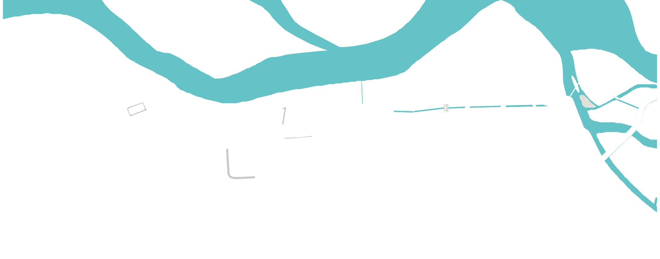

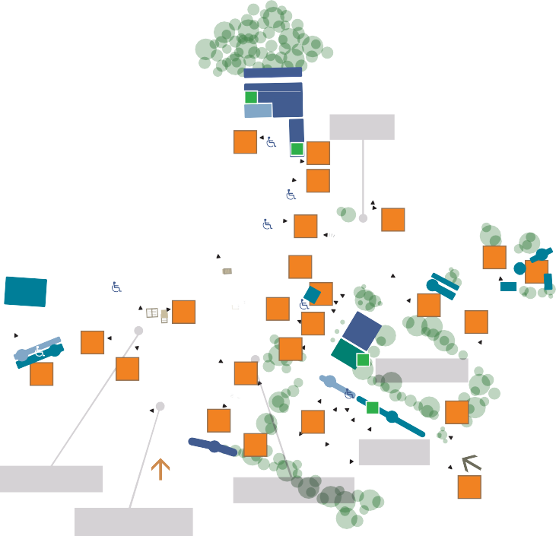

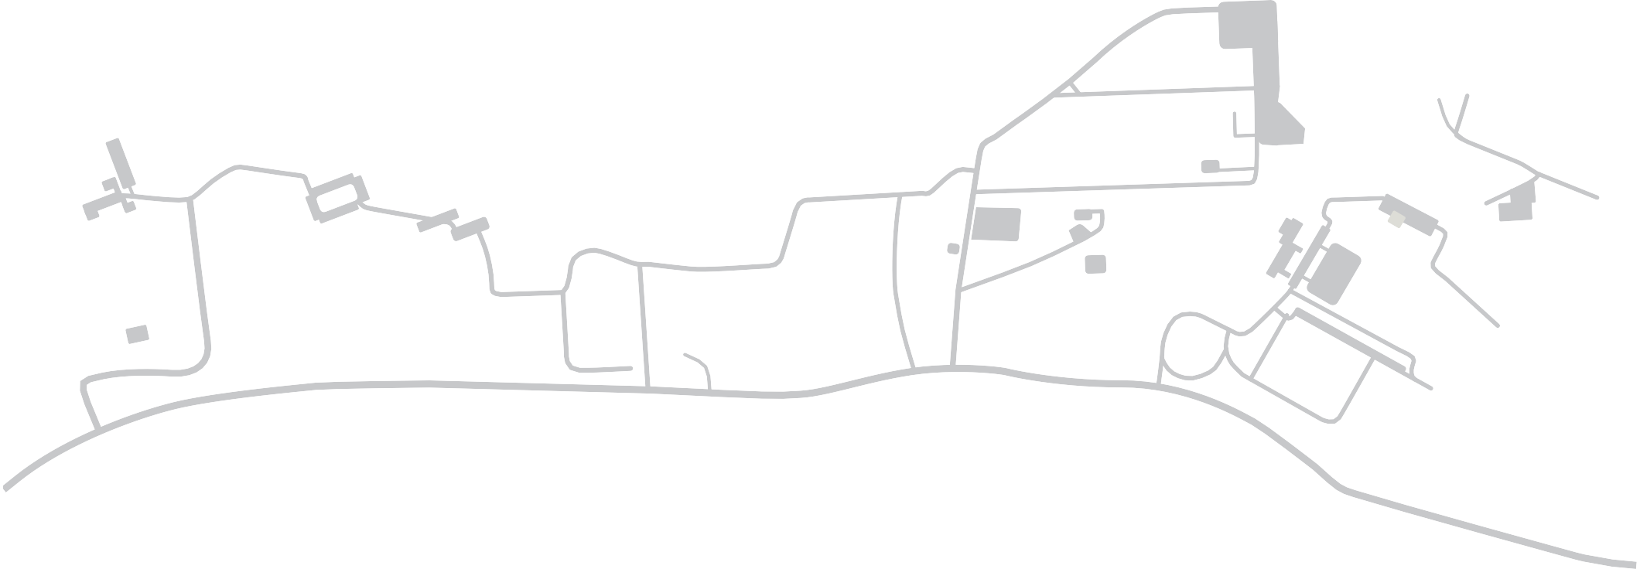


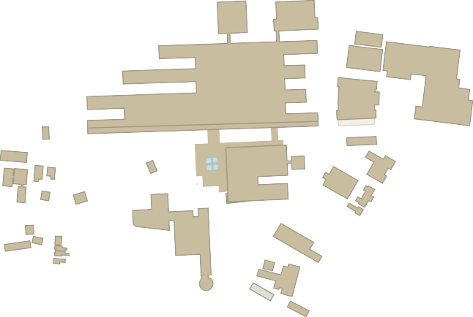

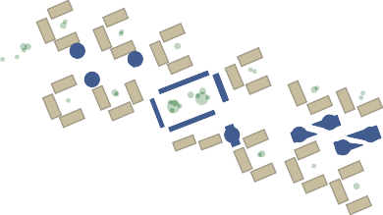
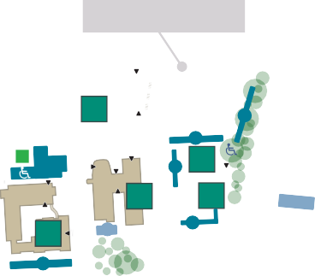






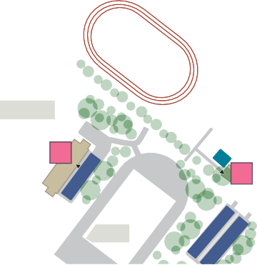
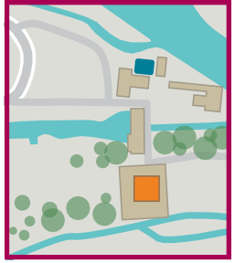
Áiteanna Páirceála ar an gCampas
Parking Locations on Campus
to M6 / M18
e
P
22
R
An Campas Theas
South Campus
An Campas Thuaidh
North Campus
Cois Abhann Ó Dheas
Riverside South
23
Plás Alumni
R Alumni Plaza
e ₉
10
A
b
h
a in n
na G a i l l im h e
Garraí an Iascaigh
Fisheries Field
R iv e
r C orrib
An Campas Spóirt, an Daingean
Sports Campus, Dangan
Cois Abhann Ó Thuaidh
Riverside North
Faiche na hInnealtóireachta
d
21
a
8
o
11
R
R
R
Engineering Lawn
M
R
39 ^{R}
R
R
ry
6
S
R
27 26
28
P
Dis t ille
12
S
7
S ₅
S
S
R
R
R
R
34
S
S
20
15
S13
S
4
S
_{S} 31
32
S
N 6
30
14
3
d
38
S
e
io g la in n e
S
25
16
R
^{e} Páirc an Choláiste
College Park
a
Oileán Altanach
Nuns’ Island
40
e S
S P
S
33
S
P
48
24
17
V
U nive rs ity R o
36
P
29
P
S
37
35
S
P
47
B ó t h a r n a Dr
18
R 19
e
S
2
n
C h
a
1
B ó t h a r n a h O l ls c o i le
i
a
r
a
s
le
á
h
i
t
n
S
B
ó
N
u a
e
w
An Chearnóg
Quadrangle
h
N c
a
s
t
U ppe r N e wc a s t le R oa d
l
ta ra
e
R
41
r
a
n
C
h
a i
s l
e á i
n N u
a U a c h c
Cearnóg Uí Argadáin
Hardiman Square
o
a
d
B
ó
t h
a
An Campas Láir
Central Campus
Gairdín Cuimhneacháin
Memorial Garden
49
Promanáid na Mílaoise
Millennium Promenade
An Campas Spóirt, an Daingean - an tIonad Spóirt Réigiúnach san áireamh
Sports Campus, Dangan - including Regional Sports Centre
B
ó t h a r a
₄₂ Páirceáil agus Taisteal
n C h a is le á in N u a
Páirc Pheile
Gaelic Football Pitch
Park and Ride
N e wc a s t le
R oa d
Eochair
Key
R
e
P
Spásanna Páirceála Roinnte Comhaltaí Foirne & Mac Léinn
red Parking Spaces
Spásanna Páirceála Foirne
R oa d
e
Ospidéal na hOllscoile, Gaillimh
University Hospital, Galway
o
l
l
e
Páirc Iomána
Hurling Pitch
t
s
50
51
S
o
C
a
l
a
Spásanna Páirceála Mac Léinn
e
43
M
CLAMPÁIL I bhFEIDHM
Teastaíonn ceadúnas páirceála cuí.
ÍOC & TAISPEÁIN
Caithdh tú ticéad Í&T nó Íoc ar an nGuthán a cheannach agus páirceáil i spásanna marcáilte ‘Í&T’ - (marcáilte le línte gorma).
CLAMPING IN OPERATION
Appropriate permits are required.
PAY & DISPLAY
You must buy a P&D ticket or Pay by Phone and park only in the spaces marked ‘P&D’- (marked with blue lines).
t
Páirc Rugbaí
Rugby Pitch
Spásanna Páirceála ‘Íoc & Taispeáin’/
B ótha r M hic C o i^{s}
Íoc ar an nGuthán (Í & T)
Pay & Display/ Pay by Phone Parking Parking Spaces (P&D)
Spásanna Páirceála do Chuairteoirí
Reserved Visitor Parking Spaces
e-Parking spaces
e-Páirceála
Príomhbhealaí isteach d’fheithiclí
Main Vehicular Entrances
Príomhbhealaí isteach do choisithe
Main Pedestrian Entrances
Cuasa do Dhaoine faoi Mhíchumas
Disabled Access Bays
Oileán Altanach
Nuns’ Island
An Campas Thuaidh
North Campus
Páirc Thraenála
Training Pitch
S 44
S
46
P
R
S
45
Páirc Shacair
Soccer Pitch
52
Páirc Haca
Hockey Pitch
R
R
Buildings & Estates - No Unauthorised Reproduction or Changes
230623

Slide 3



An Campas Spóirt, an Daingean - an tIonad Spóirt Réigiúnach san áireamh Sports Campus, Dangan - including Regional Sports Centre
An tÁras Spóirt 46 Sports Pavilion
Teach Maryville 45 Maryville House
An tIonad Taighde don Chothú Sláinte 36
Health Promotion Research Centre
Áras na Bitheolaíochta Daonna Human Biology Building | 11
Áras na Gaeilge | 15
Áras na Mac Léinn | 8
Áras Oirbsean Orbsen Building | 22
Áras Uí Argadáin Hardiman Building | 20
Áras Uí Chathail | 10
Aula Maxima | 1
Beár na Mac Léinn - Sult College Bar - Sult | 8
Bloc E Block E | 13
Bloc F Block F | 19
Bloc S Block S | 12
Bloc T Block T | 28
Bóthar na Drioglainne Distillery Road | 26
Ceoláras Emily Anderson The Emily Anderson Concert Hall | 1
Comhaltas na Mac Léinn Students’ Union | 8
Deasc Eolais na Mac Léinn (SID) Student Information Desk (SID) | 10
Foirgneamh na nDán / na hEolaíochta Arts / Science Building | 21
Fortheach Institiúid Uí Riain Ryan Institute Annexe | 3
Halla Bailey Allen Bailey Allen Hall | 8
Institiúid na hEolaíochta Cliniciúla 51 Clinical Science Institute
Ionad na hÉireann do Chearta an Duine 4 Irish Centre for Human Rights
Ionad na Seirbhísí Poist 9 Mail Services Centre
Ionad Uí Dhonnchadha - An 8 Drámaíocht, an Amharclannaíocht agus an Taibhléiriú O’Donoghue Centre - Drama, Theatre and Performance
Institiúid Lambe 50 Lambe Institute
Oideachas 14 Education
Oideachas 52 Education
Réamhdhéantán Cois Abhan 29 Riverside Terrapin
Réamhdhéantán Scoil Huston ₅ The Huston School Bubble
Scoil Scannán agus Meán ₆ Digiteach Huston Huston School of Film and Digital Media
Séipéal Naomh Columbán 48 The Chapel of St Columbanus
Síceolaíocht ₂₅ Psychology
Teach an Gheata ₂ Gate Lodge
Áras Cairnes
Cairnes Building
35
Áras Innealtóireachta Alice Perry
Alice Perry Engineering Building
34
Áras Mhaighe Seola 33
Moyola Building
An Clinic Teiripe Urlabhra agus Teanga 33
Speech and Language Therapy Clinic
An Campas Thuaidh North Campus
An Daingean A Dangan A | 43
Cúrsa Saoil Lifecourse | 41
Baile na Coiribe Corrib Village | 39
Baile an Chíorbhuí Goldcrest Village | 38
Eolaíochtaí Bithleighis Biomedical Sciences | 40
Institiúid na hEolaíochta Sonraí Data Science Institute | 44
Naíolann na hOllscoile University Crèche | 37
Páirceáil agus Taisteal Park and Ride | 42
An Campas Theas South Campus
10 Bóthar an Chaisleáin Nua 10 Newcastle Road | 47
14 Bóthar na hOllscoile 14 University Road | 49
14 Bóthar na Drioglainne 27 (An Oifig Slándála) 14 Distillery Road (Security)
An Chearnóg Quadrangle | 1
An Foirgneamh Anatamaíochta Anatomy Building | 18
An Foirgneamh IT IT Building | 23
An tIonad Spóirt Sports Centre | 30
Áras Dán na Mílaoise Arts Millennium Building | 24
Áras de Brún | 17
Áras Mhairéad (Ma) Ní Éimhigh | 16
Áras Mháirtín Uí Riain Martin Ryan Building | 7
An Campas Láir Central Campus
An tIonad Nuálaíochta agus Gnó 32 Business and Innovation Centre
An tIonad Taighde agus Nuálaíochta 31 Research and Innovation Centre
© Buildings Office - No Unauthorised Reproduction or Changes
130123

